Slide 1
VÄLKOMMEN

Slide 2
Johan Larsson HUI

Slide 3
SHOPPING FOR CHANGE: The role of retail for urban and rural development in Sweden
Özge Öner
Lecturer/Assistant Prof – University of Cambridge
Research Fellow – Institutet för Näringslivsforskning
Assistant Profe – Jönköping International Business School

Slide 4
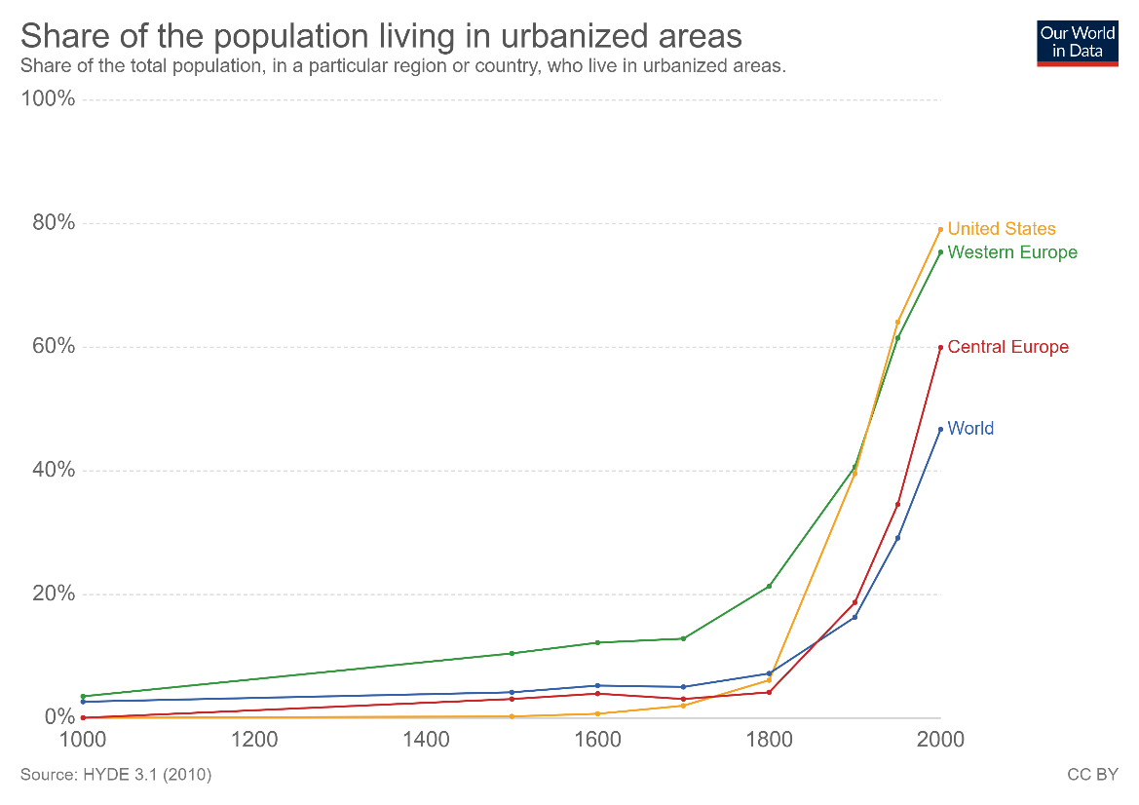
800 BC
Merchants in Ancient Greece at the ‘Agora’
13th-16th Century
The medieval market places (e.g. The Raw), Bazaars of Middle East (e.g. Grand Bazaar in Istanbul)
17th Century
Local stores substituting market stalls
19th Century
Modern day department stores
20th Century
Out-of-town shopping malls, supermarkets, chain stores, multicategory stores
21st Century
Online retailing (e.g. click-and-collect, one-click purchasing and next day delivery
&
Down-town shopping malls

Slide 5
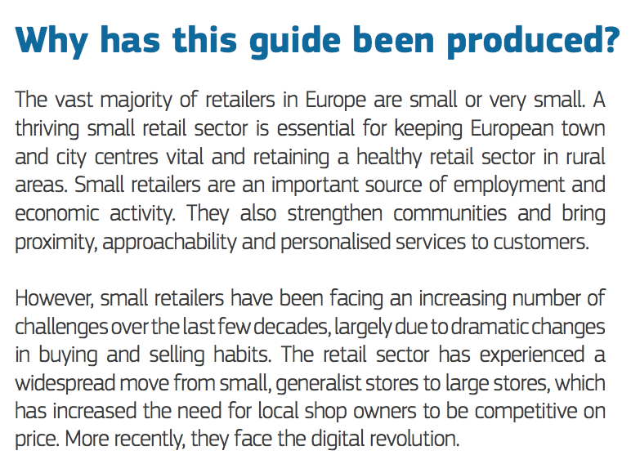
Retail and wholesale services account for 11.1% of the EU's GDP and provide around 33 million jobs (almost 15% of total employment in the EU). In retail alone, there are about 3.6 million active companies representing 4.5% of value added and accounting for almost 9% of EU jobs. They act as intermediaries between thousands of product suppliers and millions of consumers. E-commerce has increased the potential market for retailers and the scope of products available to consumers. The European Commission aims to ensure that EU wholesalers, retailers and consumers enjoy an integrated retail market.
Notes:
European retail action plan -2013
It took until 2018 to start addressing the challenges of smaller retailers in rural places

Slide 6
“Mrs. Blank, who buys her staple groceries at a neighborhood store, may be willing to motor 100 miles or more if she thinks she can find a hat that she likes – a hat that her friends at the bridge party have never seen and will admire because it came from a distant and larger city.”
Reilly, 1931, pg.1

Slide 7
Recent trends
Large firms have grown faster than the retail industry at large
There has been a decrease in the number of small and micro firms
Strategic management is not an exception but a rule
Big retailers have started to coordinate their own value chains, and big retailers have earned a stronger position compared to suppliers.
An increase in the market concentration → Spatial consequences
Structural change (e.g. New technologies) favored larger retailers over smaller peers, larger places over smaller places.

Slide 8
Retail across Swedish municipalities

Slide 9
TOP | Municipality | Retail Employment 2007 | Retail Employment 2017 | Change in Retail Employment # | Change in Retail Employment % | Change in Total Employment % | Change in night time population % | Retail Employment Share 2007 | Change in Retail Employment Share | Retail Specialization 2017 (LQ) | Rural | Border | Tourism
1 | Stockholm | 32755 | 39599 | 6844 | 0.21 | 0.23 | 0.24 | 0.06 | 0.00 | 0.96 | 0 | 0 | 0
2 | Göteborg | 16704 | 18622 | 1918 | 0.11 | 0.17 | 0.19 | 0.06 | 0.00 | 0.88 | 0 | 0 | 0
3 | Malmö | 9707 | 11261 | 1554 | 0.16 | 0.22 | 0.25 | 0.07 | 0.00 | 1.04 | 0 | 0 | 0
4 | Solna | 2774 | 4110 | 1336 | 0.48 | 0.32 | 0.31 | 0.04 | 0.01 | 0.75 | 0 | 0 | 0
5 | Nacka | 2544 | 3352 | 808 | 0.32 | 0.15 | 0.20 | 0.08 | 0.01 | 1.59 | 0 | 0 | 0
6 | Uppsala | 5826 | 6588 | 762 | 0.13 | 0.18 | 0.18 | 0.06 | 0.00 | 1.03 | 0 | 0 | 0
7 | Järfälla | 2722 | 3466 | 744 | 0.27 | 0.19 | 0.20 | 0.12 | 0.01 | 2.14 | 0 | 0 | 0
8 | Huddinge | 3593 | 4281 | 688 | 0.19 | 0.15 | 0.22 | 0.09 | 0.00 | 1.55 | 0 | 0 | 0
9 | Falkenberg | 2157 | 2785 | 628 | 0.29 | 0.13 | 0.13 | 0.12 | 0.02 | 2.22 | 1 | 0 | 0
10 | Sigtuna | 1112 | 1730 | 618 | 0.56 | 0.17 | 0.26 | 0.04 | 0.01 | 0.95 | 0 | 0 | 0
11 | Heby | 370 | 983 | 613 | 1.66 | 0.12 | 0.07 | 0.08 | 0.12 | 3.37 | 1 | 0 | 0
12 | Umeå | 3482 | 4026 | 544 | 0.16 | 0.15 | 0.14 | 0.06 | 0.00 | 1.01 | 0 | 0 | 0
13 | Jönköping | 4429 | 4960 | 531 | 0.12 | 0.16 | 0.13 | 0.07 | 0.00 | 1.10 | 0 | 0 | 0
14 | Täby | 2549 | 3002 | 453 | 0.18 | 0.13 | 0.14 | 0.11 | 0.00 | 1.93 | 0 | 0 | 0
15 | Västerås | 4115 | 4561 | 446 | 0.11 | 0.14 | 0.14 | 0.06 | 0.00 | 1.04 | 0 | 0 | 0
16 | Strömstad | 1260 | 1693 | 433 | 0.34 | 0.12 | 0.12 | 0.22 | 0.04 | 4.33 | 1 | 1 | 0
17 | Norrköping | 3911 | 4319 | 408 | 0.10 | 0.15 | 0.15 | 0.07 | 0.00 | 1.08 | 0 | 0 | 0
18 | Uddevalla | 1888 | 2255 | 367 | 0.19 | 0.07 | 0.12 | 0.08 | 0.01 | 1.46 | 0 | 0 | 0
19 | Partille | 1015 | 1372 | 357 | 0.35 | 0.15 | 0.16 | 0.09 | 0.02 | 1.85 | 0 | 0 | 0
20 | Skövde | 1562 | 1906 | 344 | 0.22 | 0.14 | 0.12 | 0.05 | 0.00 | 0.92 | 0 | 0 | 0
21 | Botkyrka | 1261 | 1587 | 326 | 0.26 | 0.16 | 0.21 | 0.06 | 0.00 | 1.02 | 0 | 0 | 0
22 | Halmstad | 2704 | 3022 | 318 | 0.12 | 0.13 | 0.12 | 0.06 | 0.00 | 1.02 | 0 | 0 | 0
23 | Örebro | 4427 | 4742 | 315 | 0.07 | 0.15 | 0.18 | 0.07 | 0.00 | 1.01 | 0 | 0 | 0
24 | Leksand | 997 | 1279 | 282 | 0.28 | 0.07 | 0.05 | 0.15 | 0.03 | 3.02 | 1 | 0 | 0
25 | Borås | 5143 | 5421 | 278 | 0.05 | 0.14 | 0.13 | 0.10 | -0.01 | 1.54 | 0 | 0 | 0
26 | Kalmar | 2379 | 2655 | 276 | 0.12 | 0.14 | 0.13 | 0.08 | 0.00 | 1.23 | 0 | 0 | 0
27 | Kungsbacka | 2012 | 2282 | 270 | 0.13 | 0.18 | 0.16 | 0.09 | 0.00 | 1.41 | 0 | 0 | 0
28 | Lidingö | 804 | 1040 | 236 | 0.29 | 0.01 | 0.11 | 0.07 | 0.02 | 1.45 | 0 | 0 | 0
29 | Eda | 569 | 802 | 233 | 0.41 | 0.19 | 0.03 | 0.17 | 0.03 | 3.39 | 1 | 1 | 0
30 | Sollentuna | 1551 | 1766 | 215 | 0.14 | 0.10 | 0.17 | 0.07 | 0.00 | 1.14 | 0 | 0 | 0

Slide 10
BOTTOM | Municipality | Retail Employment 2007 | Retail Employment 2017 | Change in Retail Employment # | Change in Retail Employment % | Change in Total Employment % | Change in night time population % | Retail Employment Share 2007 | Change in Retail Employment Share | Retail Specialization 2017 (LQ) | Rural | Border | Tourism
290 | Falun | 1611 | 1341 | -270 | -0.17 | 0.04 | 0.06 | 0.06 | -0.01 | 0.78 | 0 | 0 | 0
289 | Skara | 748 | 544 | -204 | -0.27 | 0.00 | 0.00 | 0.08 | -0.02 | 0.99 | 1 | 0 | 0
288 | Åstorp | 701 | 563 | -138 | -0.20 | 0.08 | 0.07 | 0.12 | -0.03 | 1.49 | 0 | 0 | 0
287 | Värnamo | 965 | 832 | -133 | -0.14 | 0.01 | 0.03 | 0.05 | -0.01 | 0.77 | 1 | 0 | 0
286 | Hässleholm | 1285 | 1157 | -128 | -0.10 | -0.01 | 0.05 | 0.06 | -0.01 | 0.87 | 1 | 0 | 0
285 | Sundsvall | 3370 | 3245 | -125 | -0.04 | 0.07 | 0.06 | 0.07 | -0.01 | 1.03 | 0 | 0 | 0
284 | Vänersborg | 828 | 704 | -124 | -0.15 | 0.00 | 0.03 | 0.06 | -0.01 | 0.81 | 1 | 0 | 0
283 | Arvika | 714 | 600 | -114 | -0.16 | -0.06 | 0.01 | 0.06 | -0.01 | 0.92 | 1 | 1 | 0
282 | Söderhamn | 675 | 570 | -105 | -0.16 | 0.06 | 0.04 | 0.07 | -0.01 | 0.87 | 1 | 0 | 0
281 | Härnösand | 572 | 468 | -104 | -0.18 | -0.04 | -0.02 | 0.05 | -0.01 | 0.74 | 1 | 0 | 0
280 | Älmhult | 1399 | 1301 | -98 | -0.07 | 0.16 | 0.07 | 0.14 | -0.03 | 1.93 | 1 | 0 | 0
279 | Sunne | 343 | 266 | -77 | -0.22 | 0.02 | 0.08 | 0.06 | -0.01 | 0.76 | 1 | 0 | 0
278 | Kramfors | 441 | 365 | -76 | -0.17 | 0.00 | -0.04 | 0.05 | -0.01 | 0.74 | 1 | 0 | 0
277 | Tingsryd | 399 | 323 | -76 | -0.19 | 0.01 | -0.01 | 0.07 | -0.01 | 0.93 | 1 | 0 | 0
276 | Örnsköldsvik | 1435 | 1360 | -75 | -0.05 | 0.01 | 0.02 | 0.05 | 0.00 | 0.86 | 1 | 0 | 0
275 | Tranås | 501 | 427 | -74 | -0.15 | 0.02 | 0.04 | 0.06 | -0.01 | 0.81 | 1 | 0 | 0
274 | Karlshamn | 816 | 749 | -67 | -0.08 | 0.07 | 0.03 | 0.06 | -0.01 | 0.91 | 1 | 0 | 0
273 | Essunga | 212 | 145 | -67 | -0.32 | 0.15 | 0.01 | 0.10 | -0.04 | 1.01 | 1 | 0 | 0
272 | Vetlanda | 701 | 636 | -65 | -0.09 | 0.03 | 0.02 | 0.05 | -0.01 | 0.79 | 1 | 0 | 0
271 | Olofström | 276 | 214 | -62 | -0.22 | 0.05 | 0.02 | 0.04 | -0.01 | 0.46 | 1 | 0 | 0
270 | Sandviken | 753 | 694 | -59 | -0.08 | -0.03 | 0.00 | 0.04 | 0.00 | 0.65 | 1 | 0 | 0
269 | Sollefteå | 487 | 428 | -59 | -0.12 | -0.02 | -0.04 | 0.06 | -0.01 | 0.83 | 1 | 0 | 0
268 | Malung | 388 | 329 | -59 | -0.15 | 0.02 | 0.02 | 0.07 | -0.01 | 0.99 | 1 | 1 | 0
267 | Ovanåker | 283 | 226 | -57 | -0.20 | 0.00 | -0.02 | 0.05 | -0.01 | 0.68 | 1 | 0 | 0
266 | Köping | 589 | 535 | -54 | -0.09 | 0.01 | 0.02 | 0.05 | 0.00 | 0.73 | 1 | 0 | 0
265 | Lindesberg | 449 | 402 | -47 | -0.10 | 0.04 | 0.00 | 0.04 | -0.01 | 0.63 | 1 | 0 | 0
264 | Östhammar | 434 | 387 | -47 | -0.11 | 0.07 | 0.04 | 0.05 | -0.01 | 0.67 | 1 | 0 | 0
263 | Söderköping | 348 | 301 | -47 | -0.14 | 0.08 | 0.06 | 0.08 | -0.02 | 1.09 | 0 | 0 | 0
262 | Örkelljunga | 230 | 185 | -45 | -0.20 | -0.03 | 0.04 | 0.05 | -0.01 | 0.76 | 1 | 0 | 0
261 | Krokom | 212 | 167 | -45 | -0.21 | 0.02 | 0.08 | 0.04 | -0.01 | 0.55 | 1 | 1 | 0

Slide 11
Retail branches

Slide 12
Change by Retail Categories, 2003-2015
Retail Sector | Change in Retail Employment % | Change in Retail Employment # | Change in Retail Stores % | Change in Retail Stores #
Department Store | .05 | 795 | .37 | 98
Food | .18 | 14192 | -.07 | -710
Alcohol | .07 | 286 | .03 | 13
Pharmacy | -.02 | -218 | .46 | 419
Specialized | .14 | 5462 | .05 | 547
Clothing | .13 | 5555 | .07 | 551
High-order | .23 | 7804 | -.05 | -273
Art | .8 | 12746 | 1.53 | 9737
Second Hand | 1.28 | 1879 | .67 | 478
Restaurants | .62 | 54660 | .36 | 5564
Movie | .2 | 229 | -.01 | -2
Consumer Service | -.11 | -746 | -.09 | -215
Beauty and Well-being | 1.3 | 29121 | .89 | 14322
Retail Sector | Growth in Retail Employment | Change in Retail Employment | Change in Retail Stores % | Change in # of Retail Stores
Durables | .23 | 34241 | .36 | 11138
Non-Durables | .15 | 14260 | -.02 | -278
Other | .7 | 83264 | .58 | 19669

Slide 13
Retail & Population

Slide 14
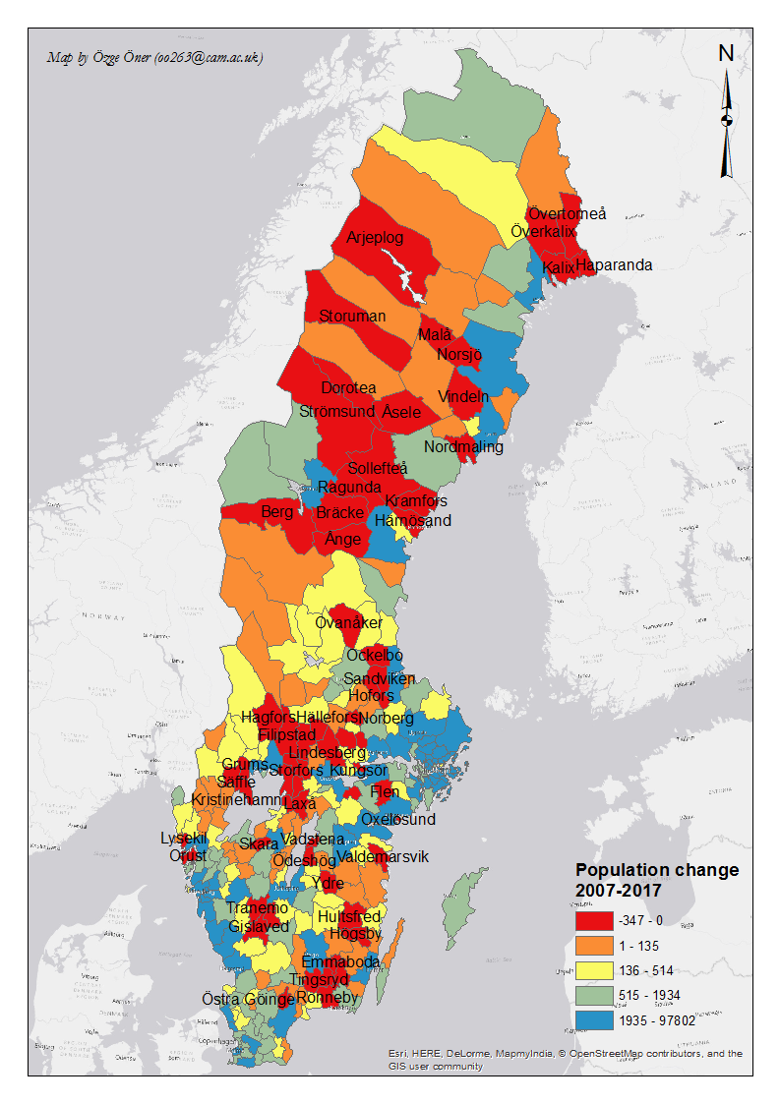
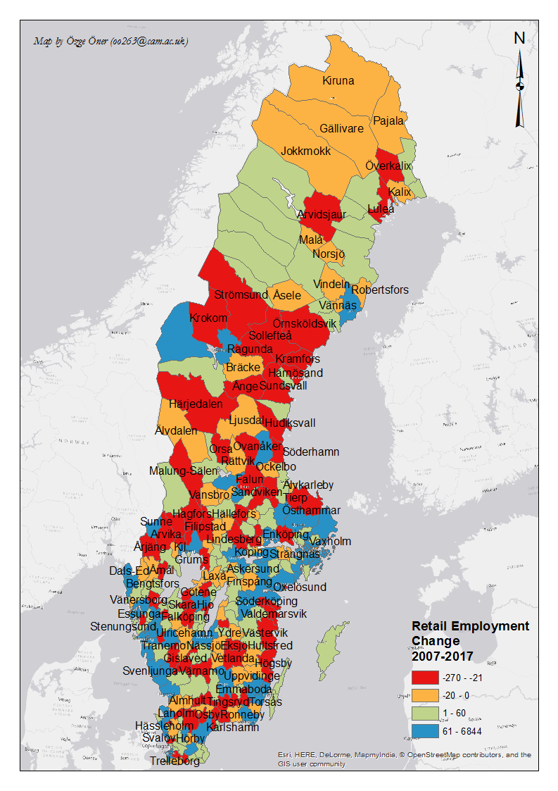

Slide 15
 | Retail Employment Growth | Retail Establishment Growth | Change in relative specialisation
Population change | 1.322*** | 0.997*** | 0.340**
 | (-6.5) | (-5.86) | (-2.03)
Type 2: Pendlingskommun nära storstad | -0.0471 (-0.83) | -0.0133 (-0.18) | -0.00402 (-0.11)
Type 3: Större stad | -0.129*** (-2.80) | -0.155** (-2.20) | -0.0414 (-1.33)
Type 4: Pendlingskommun nära större stad | -0.104* (-1.79) | -0.109 (-1.38) | 0.0153 (-0.38)
Type 5: Lågpendlingskommun nära större stad | -0.102 (-1.63) | -0.133* (-1.66) | 0.0172 (-0.39)
Type 6: Mindre stad/tätort | -0.0791 (-1.39) | -0.150** (-2.01) | 0.00848 (-0.21)
Type 7: Pendlingskommun nära mindre stad/tätort | -0.126* (-1.95) | -0.0961 (-1.20) | 0.00517 (-0.11)
Type 8: Landsbygskommun | -0.0448 (-0.53) | -0.0702 (-0.82) | 0.015 (-0.24)
Type 9: Landbygdskommun med besöksnäring | 0.169 (-1.35) | 0.0182 (-0.2) | 0.144 (-1.14)
Constant | 0.298*** | 0.376*** | -0.0334
 | (-5.27) | (-4.98) | (-0.83)
Obs | 288 | 288 | 288
Base category: Storstäder (Large cities)

Slide 16
Rank order (holding population change constant)
Större stad < Storstäder (Retail Employment and Stores)
Pendlingskommun nära större stad < Storstäder (Retail Employment)
Lågpendlingskommun nära större stad < Storstäder (Stores)
Mindre stad/tätort < Storstäder (Stores)
Pendlingskommun nära mindre stad/tätort < Storstäder (Retail Employment)

Slide 17
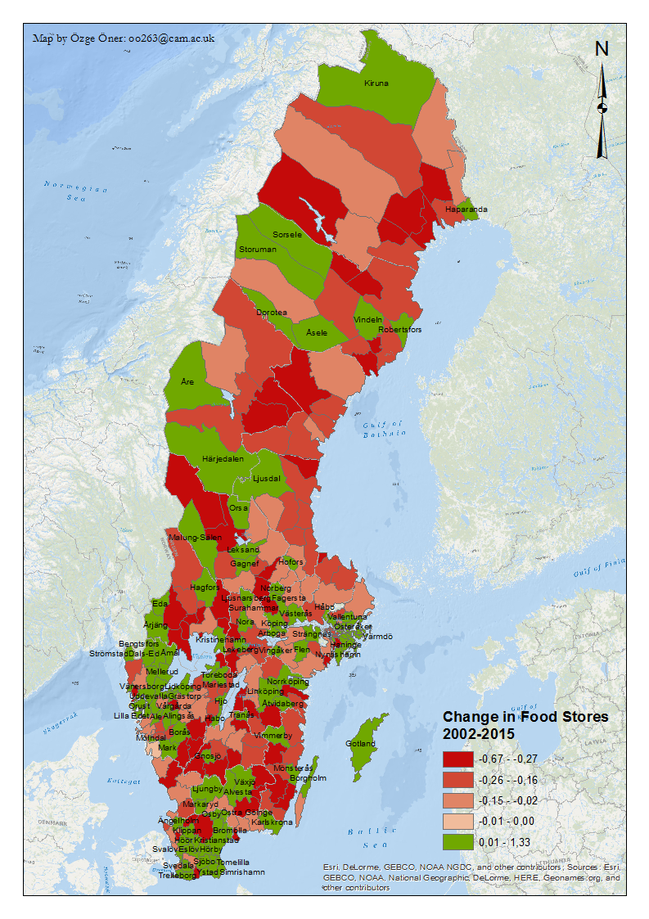
The curious case of Food retailers
Population change
Food retail supply
Population stock
Change in Food Retail Supply change

Slide 18
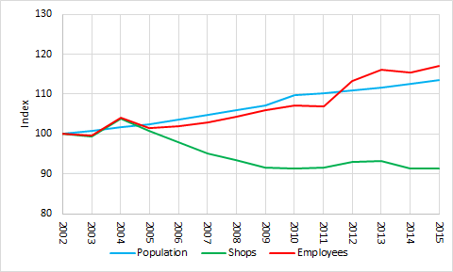
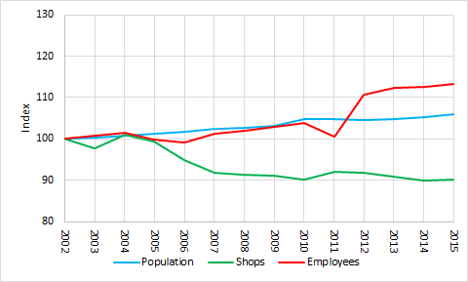
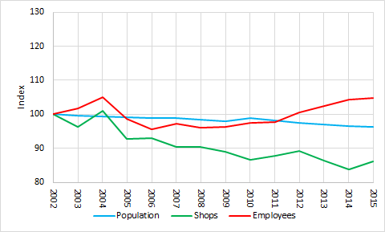
Change in population, number of food shops and their employment 2002-2015 in City Municipalities
Change in population, number of food shops and their employment 2002-2015 in Rural Municipalities
Change in population, number of food shops and their employment 2002- 2015 in Sparsely Populated Rural Municipalities

Slide 19
Variable | Description
Food retail employment | Number of jobs in food retail in the municipality
Population | Number of people living in the municipality
Metropolitan region dummies | Equals one if the municipality is considered being part of a metropolitan region
City region dummy | Equals one if the municipality is considered being part of a city region
Rural region dummies | Equals one if the municipality is considered being rural
Sparsely populated region dummies | Equals one if the municipality is considered being sparsely populated
Accessibility to wage-sums 2002 | Weighted wage sum of all municipalities. Weighted by the driving time distance between municipality i and all other municipalities. Measures the economic activity in municipality i and taking bordering municipalities into account.
The intensity of out-commuting 2002 | The number of people commuting out across the municipal border divided by the sum of in-commuters and out-commuters.
Municipal tax rate 2002 | The municipal and regional tax rate in percent
Employment share in manufacturing 2002 | Employment in manufacturing divided by total employment
Entry rate 2002 | Number of new firm-startups divided by population

Slide 20
Population & Retail (to sum)..
At the municipal level population change → retail change
Is it linear? → What happens when the last shop dies?
Smaller aggregation, e.g. neighbourhoods?
The maximum distance in the two nearest food store has actually decreased by 13 km

Slide 21
Employment

Slide 22
Retail Sector | Growth of Male Retail Employment to Growth in Total Male Employment | Growth of Female Retail Employment to Growth in Total Female Employment | Growth of Immigrant Retail Employment to Growth in Total Immigrant Employment
Department Store | .55 | .27 | .44
Food | 2.65 | .61 | .88
Alcohol | 1.17 | .11 | .48
Pharmacy | 3.53 | -.49 | 1.66
Specialized | .76 | 1.14 | .69
Clothing | .72 | 1 | .63
High-order | 1 | 2.61 | 1.34
Art | 4.55 | 6.71 | 1.84
Second Hand | 7.6 | 10.05 | 2.51
Restaurants | 5.12 | 3.53 | 1.81
Movie | .63 | 2.08 | .46
Consumer Service | -.79 | -.74 | .5
Beauty and Well-being | 13.27 | 8.29 | 4.15
Employment shares by Retail Categories, 2003-2015

Slide 23
Retail Sector | Share of Natives in Ret Empl 2003 | Share of Natives in Ret Empl 2015 | Growth in Share of Natives in Retail 2003-2015 | Share of Immigrants in Ret Empl 2003 | Share of Immigrants in Ret Empl 2015 | Growth in Share of Immigrants in Retail 2003-2015
Department Store | .89 | .87 | -.03 | .11 | .13 | .24
Food | .87 | .83 | -.05 | .13 | .17 | .35
Alcohol | .91 | .89 | -.02 | .09 | .11 | .24
Pharmacy | .88 | .73 | -.16 | .12 | .27 | 1.16
Specialized | .89 | .86 | -.03 | .11 | .14 | .28
Clothing | .89 | .86 | -.03 | .11 | .14 | .26
High-order | .91 | .86 | -.05 | .09 | .14 | .55
Art | .85 | .82 | -.04 | .15 | .18 | .25
Second Hand | .81 | .78 | -.04 | .19 | .22 | .18
Restaurants | .69 | .58 | -.17 | .31 | .42 | .37
Movie | .89 | .88 | -.01 | .11 | .12 | .1
Consumer Service | .83 | .74 | -.1 | .17 | .26 | .51
Beauty and Well-being | .83 | .72 | -.13 | .17 | .28 | .65
Relative importance of retailing for employment by Place of Birth, 2003-2015

Slide 24
Some remarks

Slide 25
The narrative is important!
Security and retail → “Eye upon the street”
Local resource framework
Analogous relationship between place attraction and retailers
Policy? Flexibilities at the local institutional level
Geography of technology → Small places, small retailers

Slide 26
Ozge_Oner
oo263@cam.ac.uk

Slide 27
Stina Qubti- Busfrö Nytt och bytt
Elisabet Elmsäter Vegsö- Svensk Handel

